Slide 1
Computer Architecture and Microcontrollers Microproject
Temperature Controlled Fan

Slide 2
Prepared by :
EC4A
Augustine J. Kadavan – 15
Sidharth S. – 52
P.V. Sridhar - 56

Slide 3
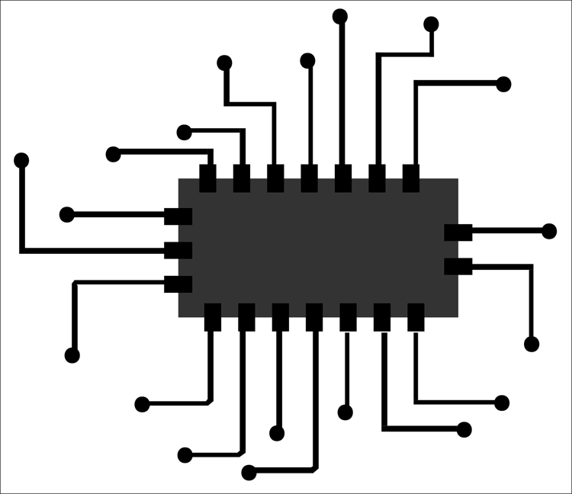

Aim
Design and implement a temperature-controlled fan system using an 8051 microcontroller to adjust fan speed based on ambient temperature, ensuring efficient cooling and energy savings.

Slide 4
Scope
Temperature sensing
Fan speed control
Power efficiency
User-friendly interface
Applied in CPU cooling systems

Slide 5
Block Diagram
Temperature Sensor
ADC
8051 MC
Amplifier
DC Motor
LCD Display

Slide 6
Algorithm
Initialize the 8051 microcontroller, ADC0804, LCD display, and other necessary peripherals.
Set up the ADC0804 to convert the analog temperature signal from the temperature sensor to a digital value. Configure the appropriate input channel and reference voltage.
Configure the LCD display to initialize and enable temperature display.
Continuously read the analog temperature value from the ADC0804 using the appropriate input channel.
Convert the digital temperature value to a readable format (e.g., Celsius or Fahrenheit) using appropriate mathematical formulas or lookup tables.

Slide 7
6. Display the temperature reading on the LCD display.
7. Calculate the desired fan speed based on the current temperature. Define a mapping between temperature and fan speed, either using a predefined table or an algorithm.
8. Adjust the duty cycle or frequency of the PWM output based on the desired fan speed. Use the 8051 microcontroller's PWM capabilities or a separate PWM module if available.
9. Control the Darlington transistor to regulate the power supplied to the DC motor. Adjust the transistor's base voltage using the PWM signal to control the motor speed.
10. Continuously monitor the temperature and update the fan speed accordingly. Repeat steps 4 to 9 in a loop to maintain real-time temperature control.

Slide 8
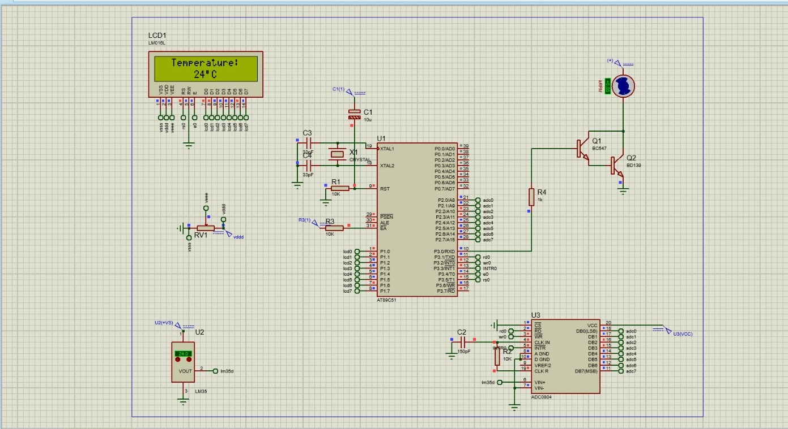
Schematic

Slide 9
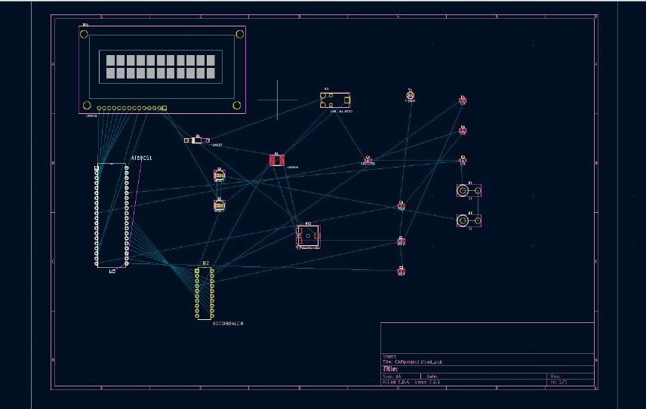
PCB

Slide 10
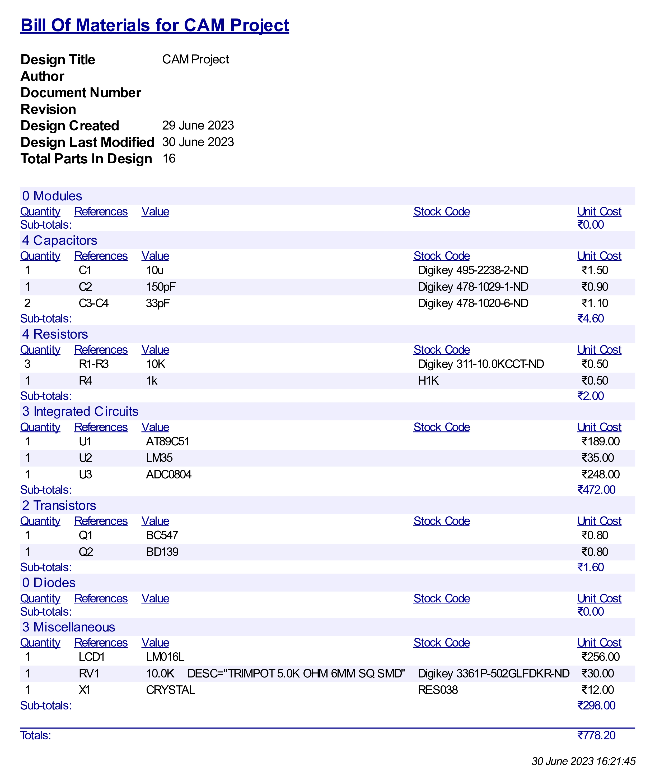
Bill of Materials

Slide 11
References
https://youtu.be/Y6M2b-mFh-s
https://github.com/AdityaKshettri/Temperature_Controlled_Fan
https://youtu.be/W9cLnIjvybo

Slide 12
Thank you

